Slide 1
Basic Biological Concepts
The Dynamic Genome
Section 2 – Lecture 5

Slide 2
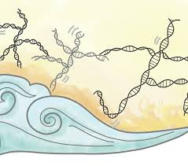
The genomes of every organism are constantly changing
Continuous environmental pressure to mutate balanced by mechanisms for repair
Sources of new genetic combinations formed by infection with viruses
The evolution of sexual reproduction and the subsequent recombination of DNA

Slide 3
A Variety of Mechanisms Exist for Changing Gene Sequence in a Genome
Mutation - Accidents/mistakes followed by non-random survival
Horizontal Transfer - Genes transferred between organisms, in the lab and in nature
Transposable elements in the genome
DNA Shuffling - Reassortment during homologous recombination
Gene Duplication - provides an important source of genetic novelty
DNA gains and losses over time
New genes are generated from preexisting genes, there is no known mechanism for new synthesis!

Slide 4
1. DNA Mutations
DNA mutation is the loss or gain of significant amounts of DNA, including chromosomal deletions, additions
Mutation rates are extremely low but are an essential component of evolutionary change
The most common source of DNA mutation is error during DNA replication – especially during meiosis!
Environmental damage to the DNA is independent of DNA mutation but can also be an underlying cause of it

Slide 5
Potential outcomes in protein expression and phenotype
Silent mutations have no effect on the amino acid produced because of redundancy in the Genetic Code
Missense mutations still code for an amino acid, but not necessarily the right amino acid
Nonsense mutations change an amino acid codon into a stop codon, nearly always leading to a nonfunctional protein
Frameshift mutation result from the insertion or deletion of nucleotides that alter the reading frame

Slide 6
Intragenic Mutation
Only 1 nucleotide pair per 1,000 is randomly changed in the germline per 1 million years
however.....
This means that in a population of 10,000 every possible nucleotide substitution will have been tried out ~20 times in a million years

Slide 7
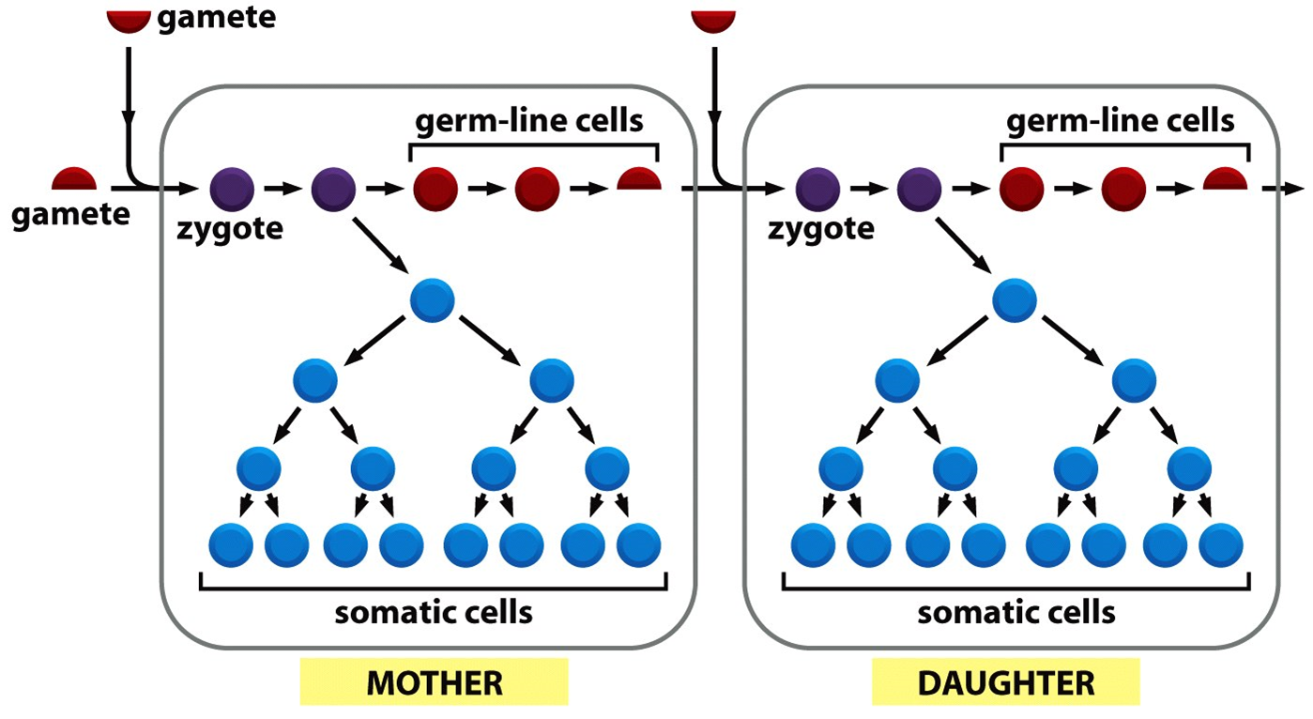
Mutation rates are extremely low but are an essential component of evolutionary change
For mutations to become part of the multicellular genome they must occur in the cells of the germ line
Somatic mutations may or may not affect the individual but cannot affect the population
Low rates of mutation can result in high rates of evolution in single-celled organisms

Slide 8
The most common source of DNA mutation is error during DNA replication
There is an average mistake of 1 base pair every 10,000
Due to proofreading and repair mechanisms this rate declines to 1 every 1,000,000,000 (1 billion)
When this occurs during meiosis the potential impact on the population is at its highest
Also inherent in meiosis are assortment and cross-over events that lead to highly significant changes in germ line DNA sequences

Slide 9
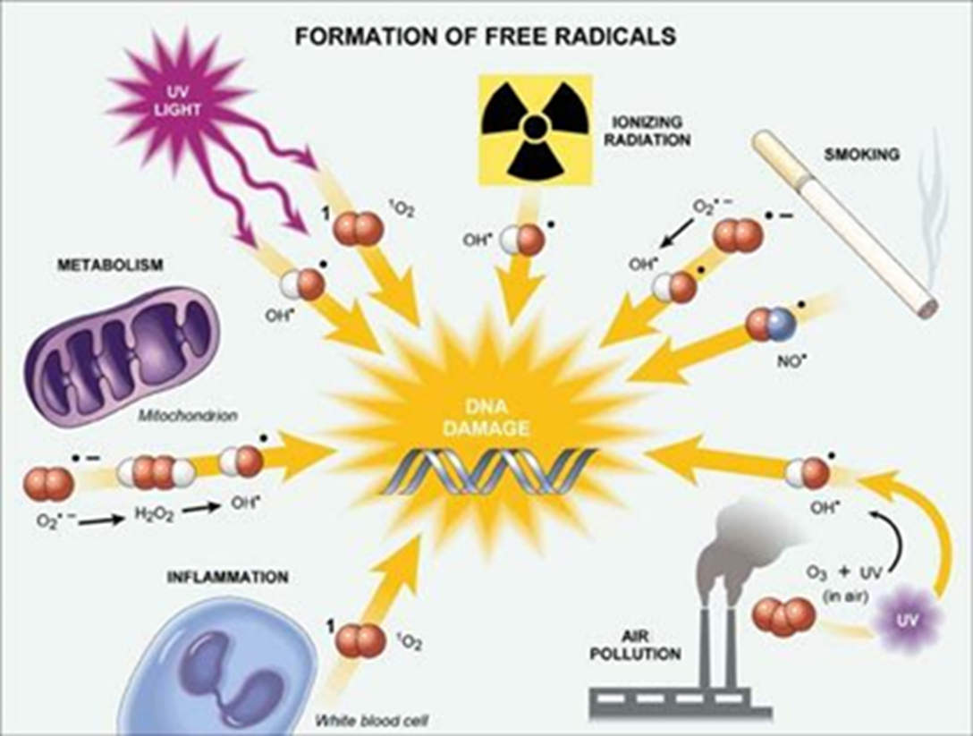
Reactive Oxygen Species (ROS) activity can produce single-stranded and double-stranded breaks in the DNA
Also called Free Radicals
ROS are generated by endogenous metabolic processes and by exogenous mechanisms
Potential outcomes range from gene shuffling in or across chromosomes, gene inactivation, altered gene regulation, gene duplication
We have DNA repair systems that can remove even these mutations

Slide 10
2. Horizontal Gene Transfer
Horizontal or lateral gene transfer (HGT) occurs by the direct movement of DNA between two organisms.
There is reason to believe that any two major groups of organisms—including humans—can share their genetic codes
HGT is an important factor in the evolution of many organisms.

Slide 11
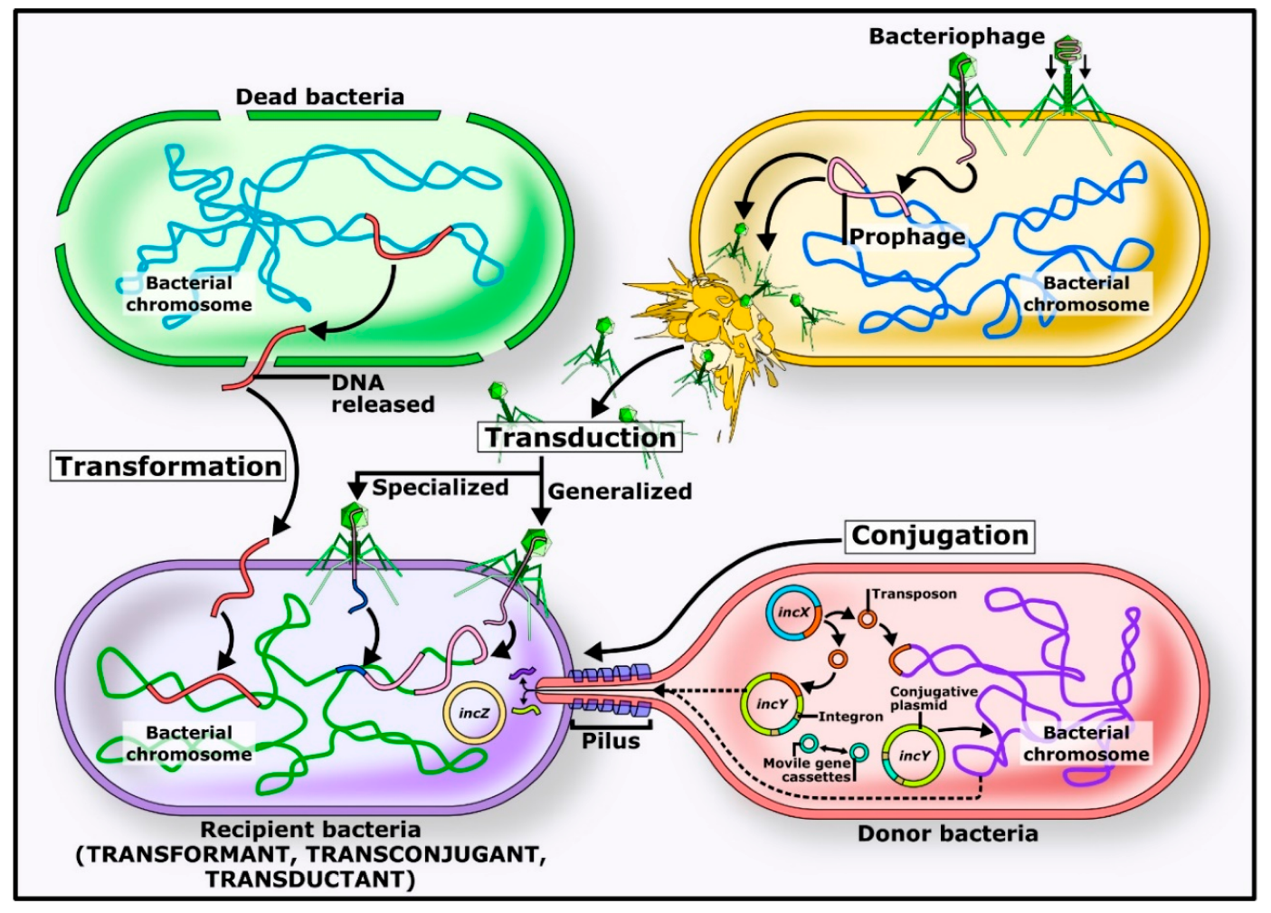
Several Mechanisms in Prokarya
Transformation by free DNA
Transduction by bacteriophages
Conjugation by donor bacteria
HGT is the primary mechanism for:
the spread of antibiotic resistance in bacteria
the evolution of bacteria that can degrade human-created pesticides
the evolution, maintenance, and transmission of virulence.

Slide 12
3. Transposable Elements (TE)
Transposons are pieces of DNA that move between genomes by means other than parent-to-offspring inheritance.
Colonize genomes and spread within them – many resemble viruses.
The arrival of a new TE in a host genome can have detrimental consequences because TE mobility may induce mutation.
Can also be beneficial by introducing new genetic material into a genome and promoting the shuffling of genes and TE domains among hosts.
Can create new genes by integration within and fusion with host gene segments

Slide 13
Autonomous TEs encode the proteins required for their own movement within an individual genome
Can disrupt gene function, alter regulation
Movement increases the TE copy number and generates chromosomal rearrangement hotspots
10% of currently occurring mouse mutations are transposon-driven

Slide 14
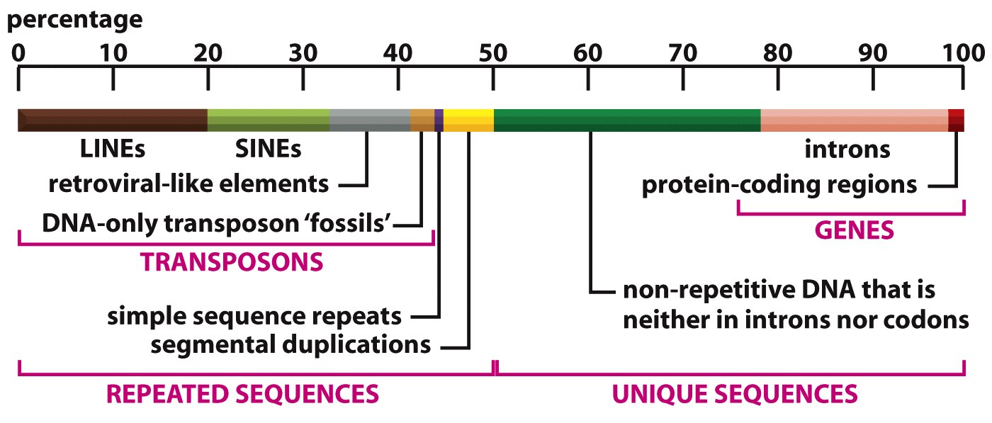
Half of all human DNA has homology to known transposons

Slide 15
4. DNA Shuffling
Incomplete or partial cross-over events
Pieces of different genes can be combined to form new genes with hybrid functions

Slide 16
DNA Shuffling can recombine genes for good or bad
The process that contributes the most to genetic shuffling is meiosis.
DNA shuffling is important for evolution because it can introduce new combinations of genes every generation.
However, it can also break up "good" combinations of genes.
Genetic shuffling can also happen between prokaryotes, like bacteria, but it works through a different mechanism.

Slide 17
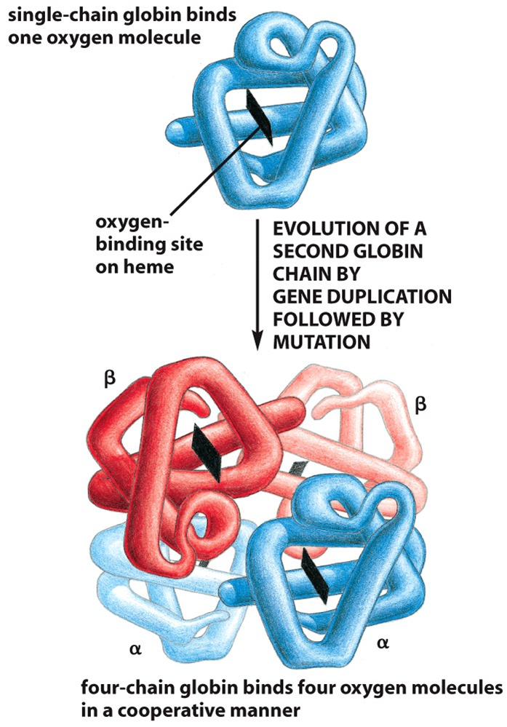
5. Gene Duplication
During meiosis, crossover mutations can form multiple copies of an exon, a gene, a chromosome or the entire genome.
The organism survived just fine with one copy so it only repairs damages to one copy, leaving the other to freely mutate.
Once in a blue moon the mutated copy develops new, advantageous functions.

Slide 18
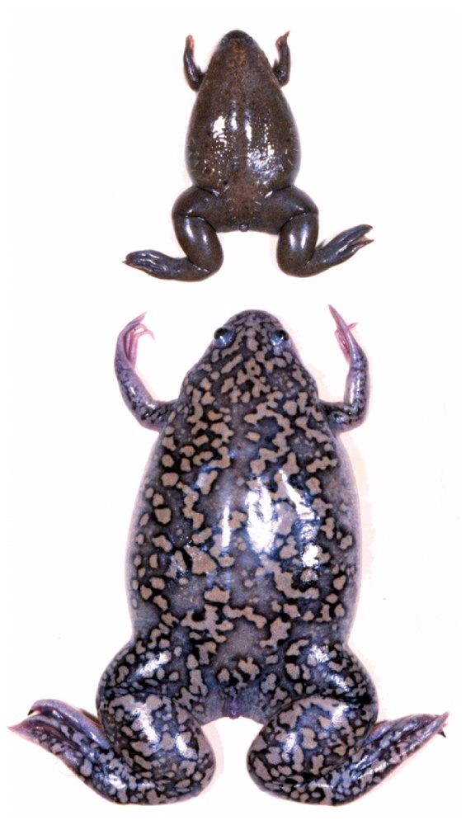
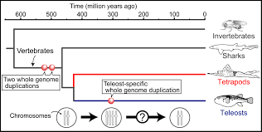
Whole Genome Duplication!
Xenopus
tropicalis
Xenopus
laevis

Slide 19
Gene Families
Gene duplications give rise to families of related genes in a single cell
More than 200 gene families are common to all three domains
The function of a gene can often be deduced from its sequence

Slide 20
Duplication and Divergence Give Rise to Related Genes – Very Common Events!
4873 protein-coding gene families have been identified in life on earth
264 are designated ‘ancient’ - in all lineages
63 are ubiquitous in all genomes analyzed
Most of the shared ‘ancient’ families perform:
replication and transcription
translation and amino acid metabolism

Slide 21
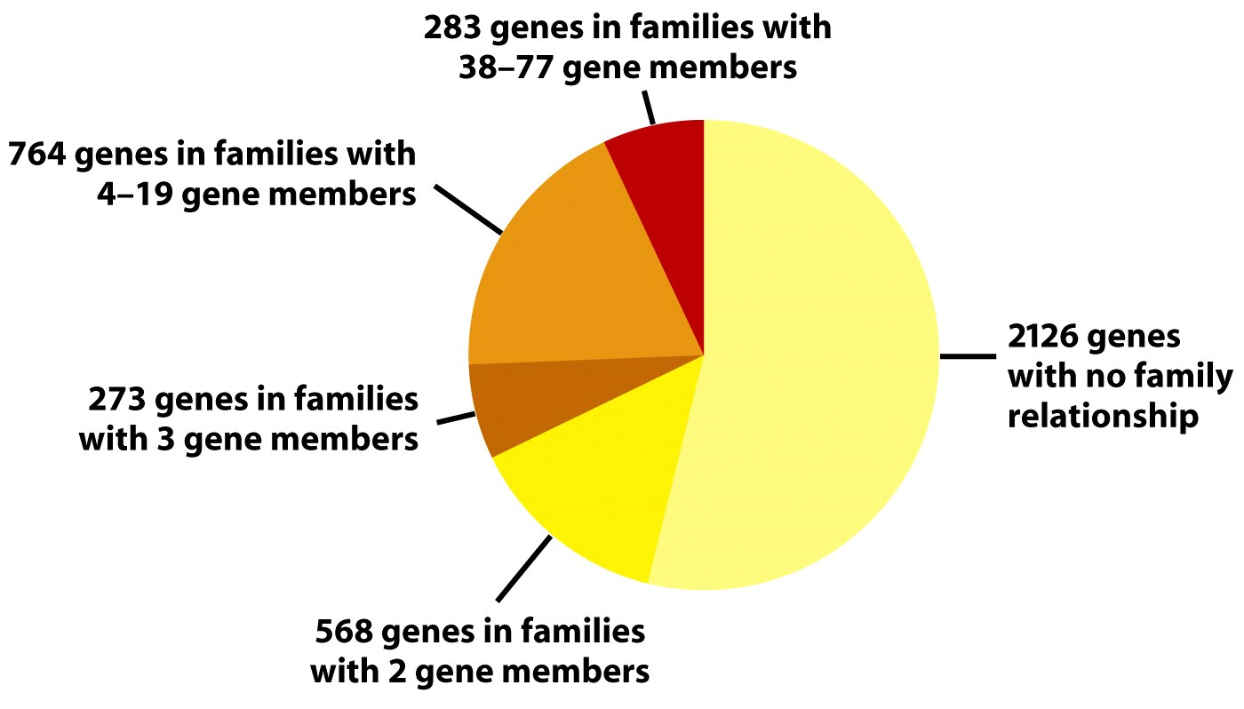
Bacillus subtilis
4014 Genes
47% in families
ABC Transporter
family has 77
members in this
single bacterium!

Slide 22
Expansion of gene families gives rise to new functions
Transcription factors regulate gene expression and, thus, cell diversity and complexity in multicellular organisms
bHLH TFs: 7 in yeast, 41 in worms, 84 in flies, 131 in humans
Adhesion and signaling are far more critical in multicellular animals
2000 major plasmamembrane proteins in worms not present or in low numbers in yeast

Slide 23
The size of any genome reflects the relative DNA addition and DNA loss over time
Both loss and gain occur constantly
Because of functional redundancy, genes are rapidly silenced or lost from duplicated genomes.
The relative rates determine genome size

Slide 24
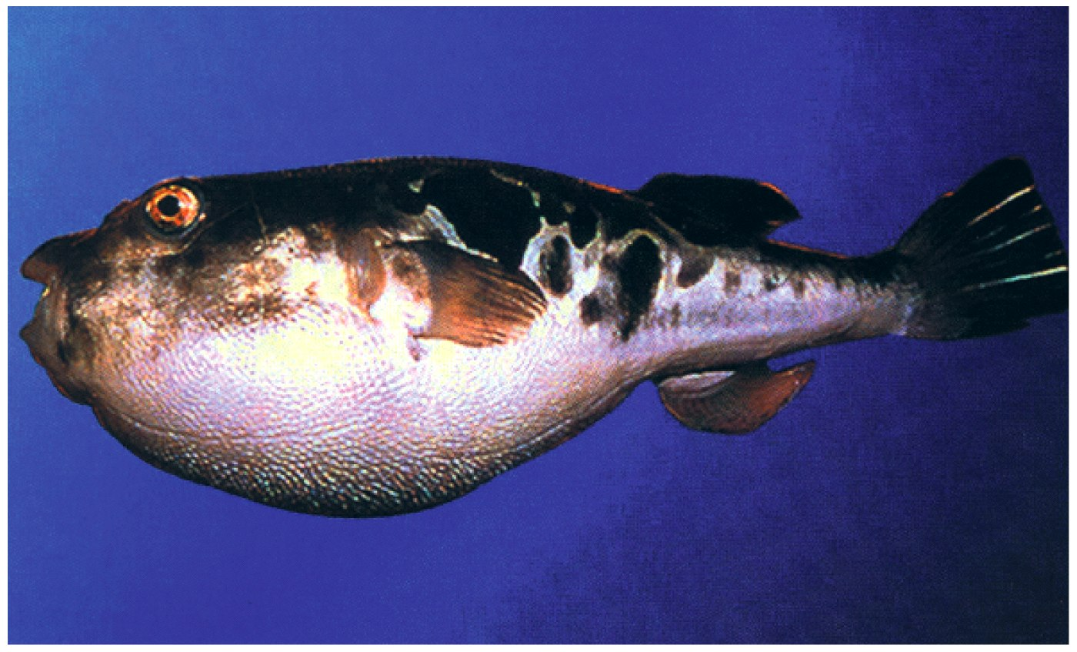
The Fugu – experienced a long period of low rates of
DNA addition accompanied by normal rates of DNA loss

Slide 25
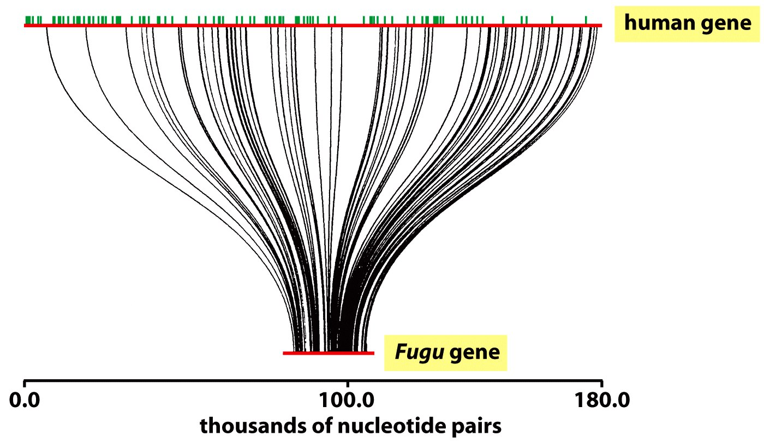
The huntington Gene
-High homology
-Perfect exon alignment
-Small introns
-Little non-coding DNA
Figure 4-82 Molecular Biology of the Cell (© Garland Science 2008)

